Slide 1

Rockbuster Stealth:
Strategic Analysis and
Insights
Evaluating Market Entry Strategies and Competitive Positioning Dec 25, 2025
Presented by Maxwell Appiah, Data Analyst

Slide 2
Background:
Rockbuster Stealth LLC, previously known for its global Project Overview network of rental stores, is evolving to meet the demands of a market dominated by streaming services like Netflix and Amazon Prime. To stay competitive, our management team is leveraging our existing movie licenses to launch an online video rental service.
Objective: Answer key business questions that are critical to the successful launch of this new streaming platform.
Project
Overview

Slide 3





What was the average rental duration for all videos?
Which movies contributed the most/least to revenue gain?
Do sales figures vary between geographic regions?
Key
Questions
Which countries are Rockbuster customers based in?
Where are customers with a high lifetime value based?
What movie genres generate the most revenue?

Slide 4
Summary Statistics
Average Rental Duration:
5 days
Average Rental Rate: $0.99
Total Number of Films: 1,000
Films Never Rented: 42
Average Film Length: 115 minutes
Most Common Movie Rating: PG-13
Number of film languages: 1

Slide 5
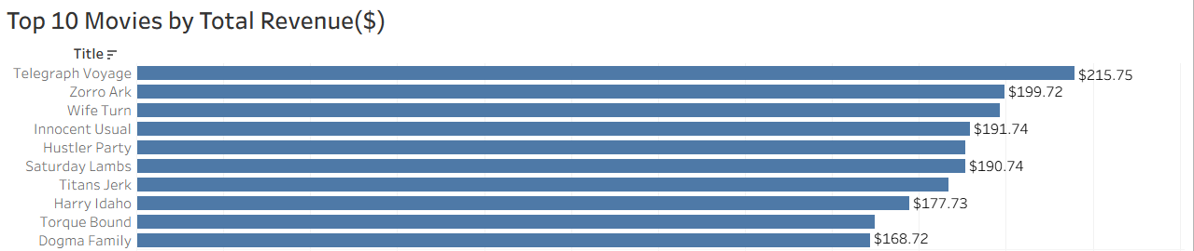
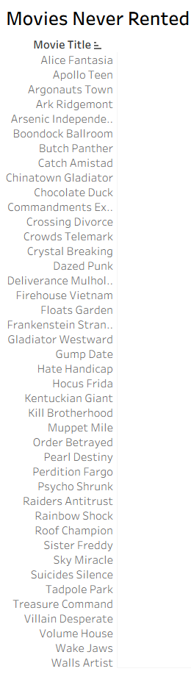
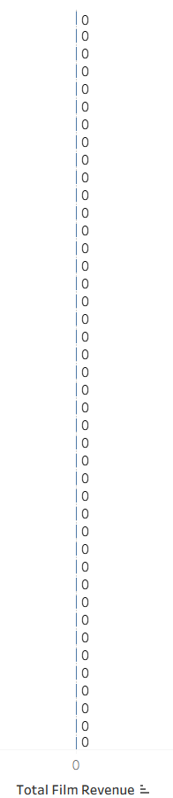
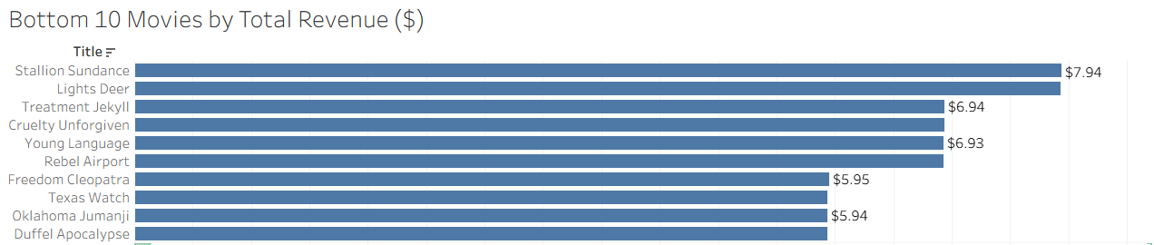
Which movies contributed the most/least to revenue gain?

Slide 6
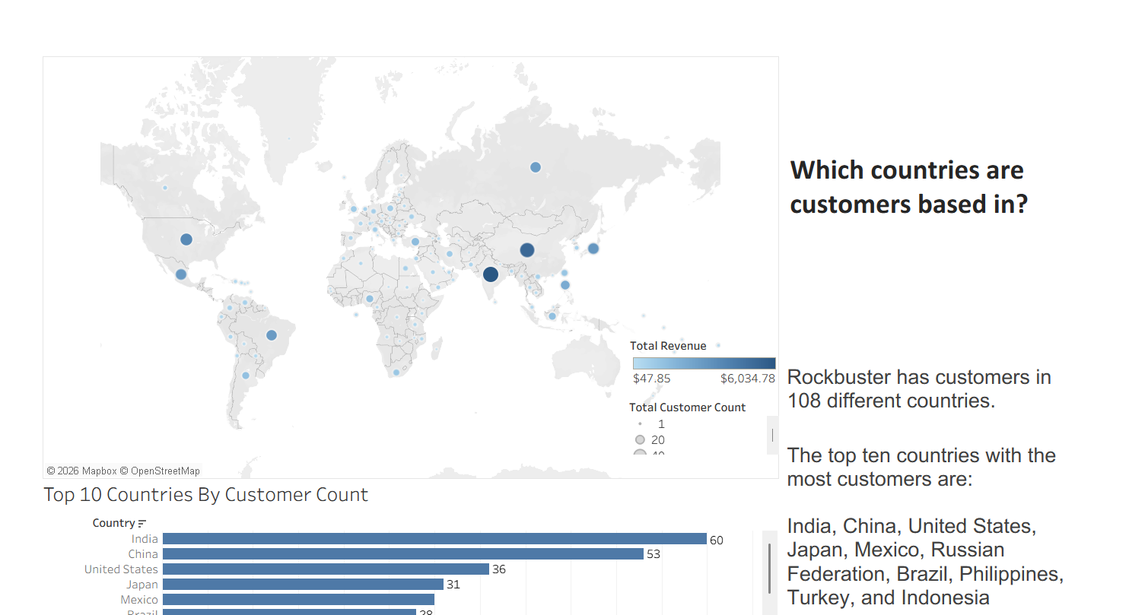
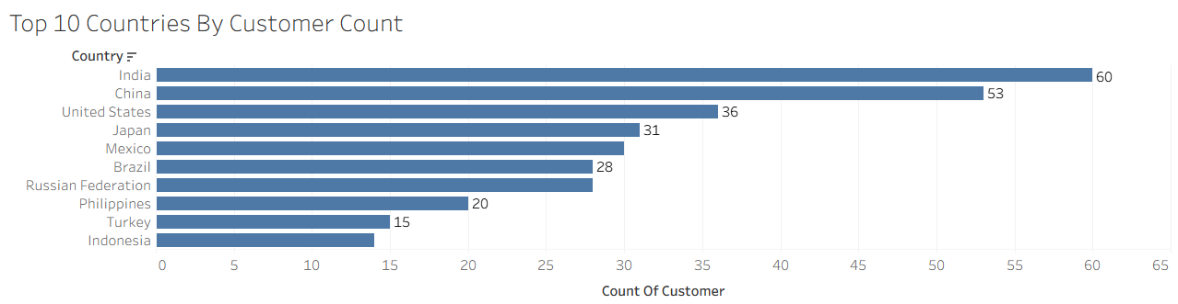

Slide 7
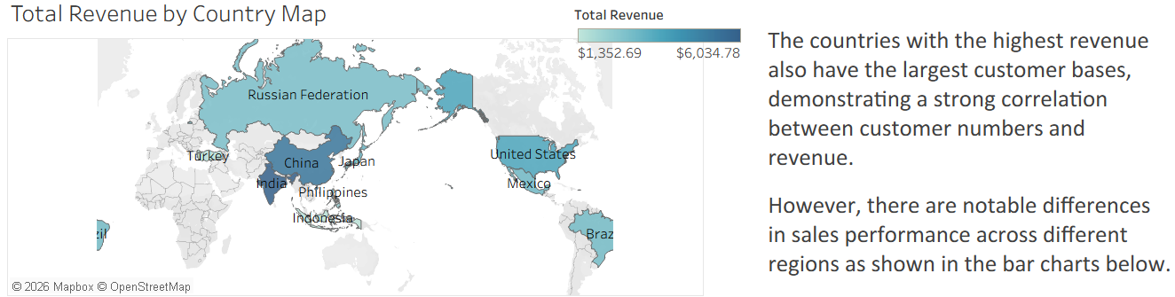
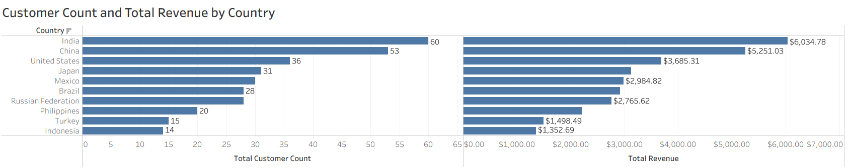
Do sales figures vary between geographic regions?
India is responsible for the largest majority of revenue.
It is also the Country with largest customer base

Slide 8
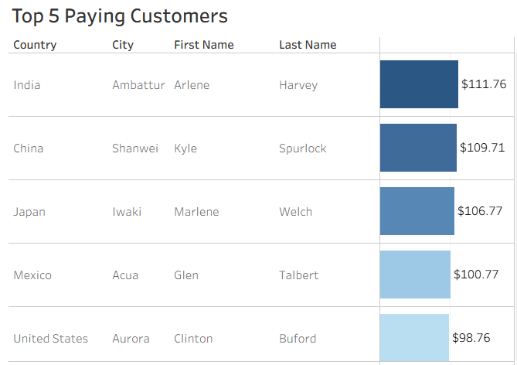
Where are
customers with a high lifetime value based?

Slide 9
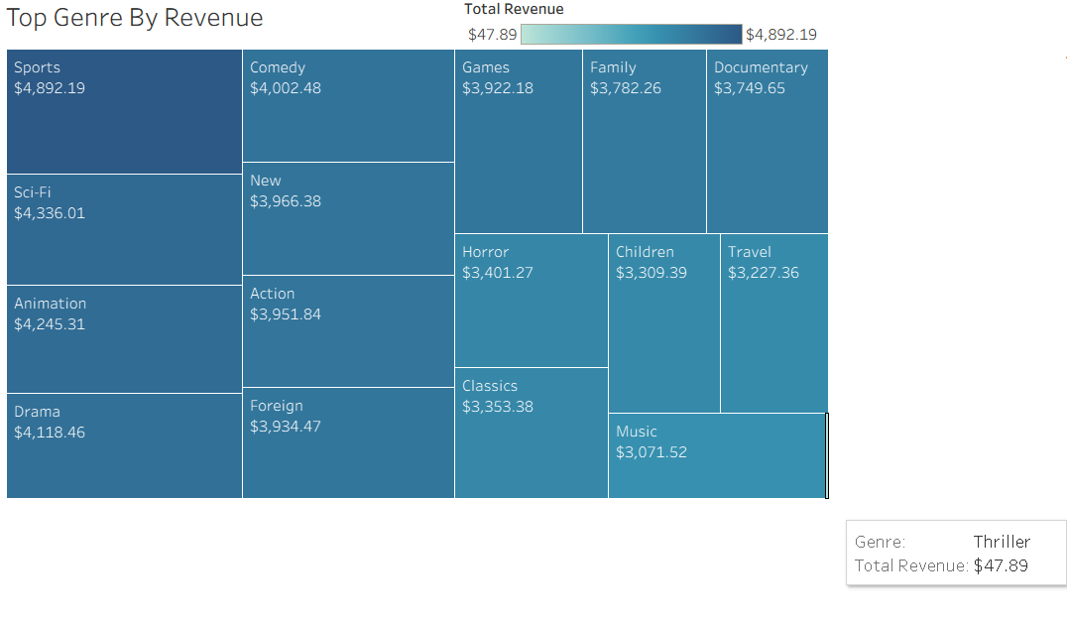
What movie genres generate the most revenue?
Sports, Sci-Fi, Animation, Drama, and Comedy are the most popular movie genres generating ~35% of the total revenue.
Thriller films are the least popular only generating a revenue total of $48.

Slide 10

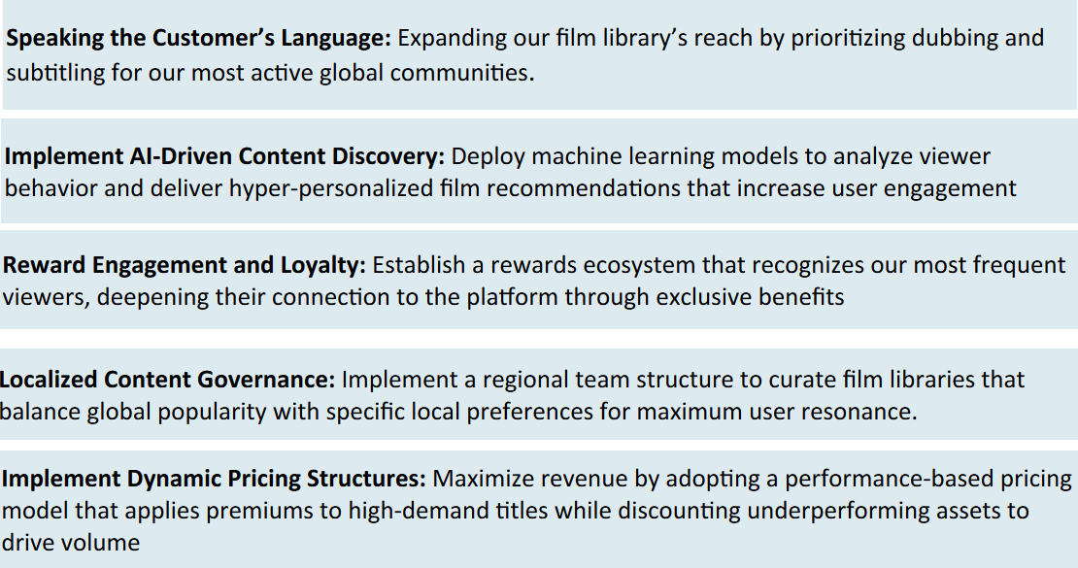
Recommendations

Slide 11
Thank You
https://public.tableau.com/app/profile/maxwell.appiah5460/viz/RockbusterStealthLLCStoryFinal/RockbusterStealthLLCStory?publish=yes

